Slide 1
Chest X-ray Diagnosis on Pneumonia
Team 43
Weixuan Sun 1003803048
Jiawen Li 1002904253
Qiaoyi Yan 1003130774
Yiran Qiu 1004172290
Notes:
Hello everyone, this is team 43. Our project is about applying machine learning technics in diagnosing chest radiograph with pneumonia.
First, I would like to ask u a question, can u find out the difference between the two radiographs? Clearly, the right one is blurrier than the left one. The right one is chest radiograph of lung with pneumonia, and the other one is for normal lung.
What about these two x-rays? I believe it takes more time for u to find out the difference between these two. The left one is chest radiograph of lung with viral pneumonia, the right one for bacterial pneumonia.
As the virus or bacteria goes into your lung, you start cough. As the COVID-19 is still spreading, you will go to the hospital for further tests. For the traditional way, the doctors will diagnose each chest radiograph in person which increases the workload of doctors in the pandemic. The team want to reduce the doctors’ workload, boost the early-stage pneumonia chest radiograph diagnosing, and achieve patient’s self-diagnose by applying machine learning.

Slide 2
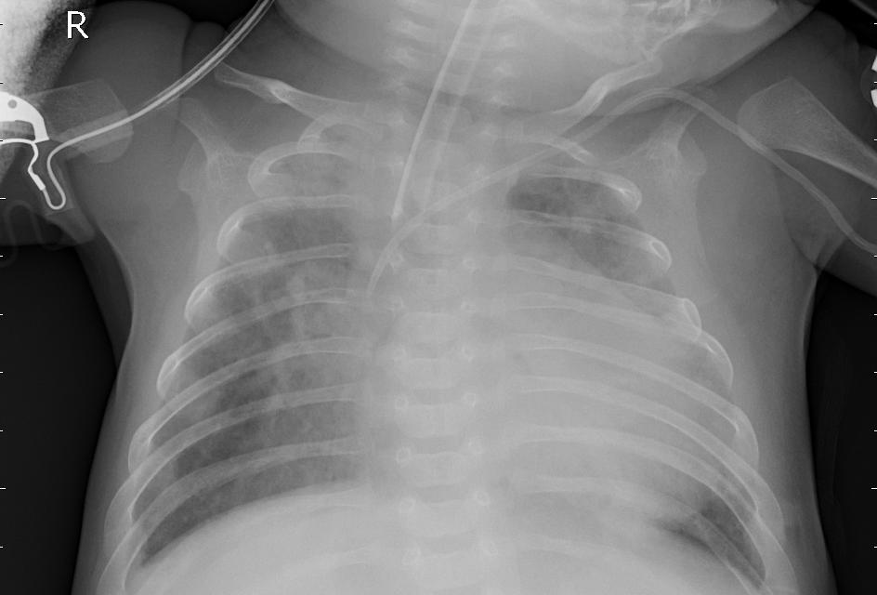
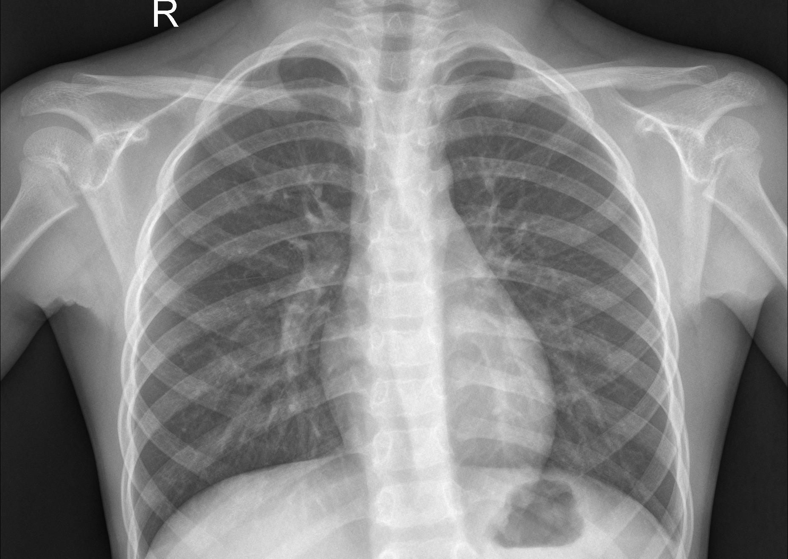
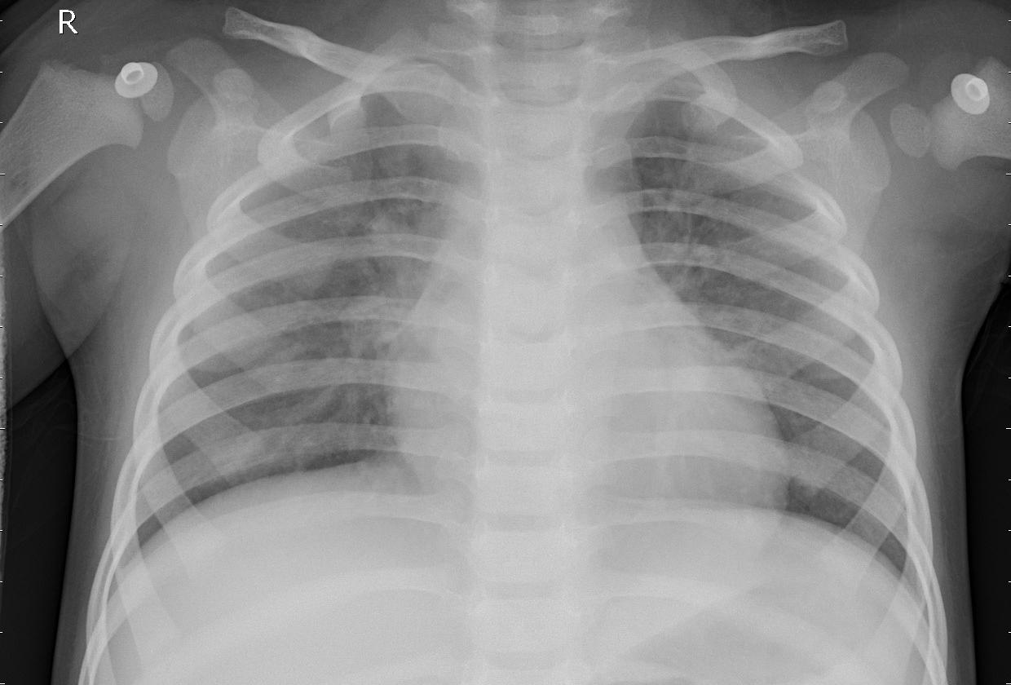
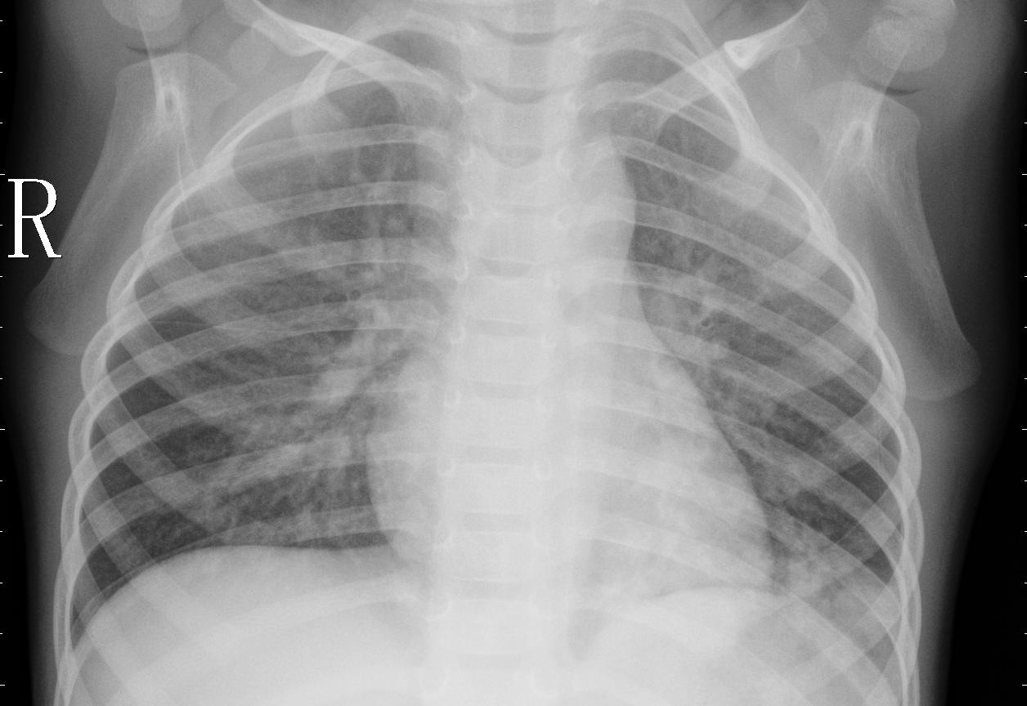
Let’s look at some chest x-ray images...
Notes:
Can u identify any difference between the two x-rays of a person’s chest? (one second)
Clearly the right one is more blurry than the left one. The left one is the x-ray of healthy lung, but the right x-ray is the lungs with
Pneumonia.
(another click)
What about these two?
(one second)
It’s hard for people to find the difference betweens these two x-rays.
The left x-ray is the lung with virus, and the right one is the lung with bacteria.

Slide 3
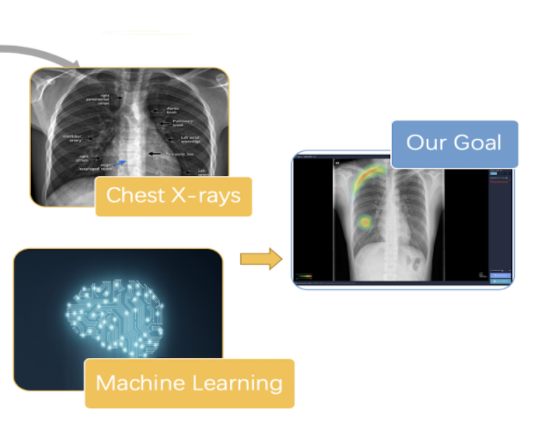




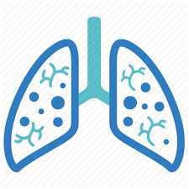
Our Goal
Notes:
The world is no longer the same as it was and we are all in this pandemic together.
As the virus or bacteria goes into your lung, you start cough. As the COVID-19 is still spreading, you will go to the hospital for further tests. For the traditional way, the doctors will diagnose each chest radiograph in person which increases the workload of doctors in the pandemic. The team want to reduce the doctors’ workload, boost the early-stage pneumonia chest radiograph diagnosing, and achieve patient’s self-diagnose by applying machine learning.
Background
• COVID-19 is highly contagious and develops pneumonia symptoms on the patients
• Health care systems have been under great pressure operating under COVID-19.
Motivation
• Help relieve the pressure brought by COVID-19 for patients and doctors.
• Apply what we learned in APS360 to real-life problems.
Approaches
Chest X-rays:
• Chest radiography is often the initial imaging modality of choice for clinicians who are evaluating patients with suspected COVID-19 pneumonia.
Machine Learning:
• Plenty of x-ray datasets available for model training.
• Machine learning algorithms allow models to independently adapt. Models will learn from previous computations to produce reliable, repeatable results.
Final Goal
• Delivers a tool that identifies the condition of pneumonia on a given chest x-ray, and also allows Patients to self-diagnose / doctors to speed up their early-stage pneumonia x-ray diagnosis process.
### NEW Script
With our healthcare system heavily impacted by the current COVID-19 situation, the team sees an opportunity to help relieve the workload and stress for doctors and radiologist, and we came up with this project to develop an ML model that reads chest x-rays and diagnoses the presence of different types of pneumonia. This could potentially allows patients to self-diagnose and doctors to speed up their early-stage pneumonia x-ray diagnosis process.

Slide 4
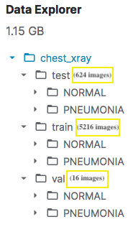
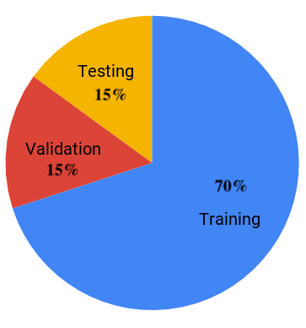
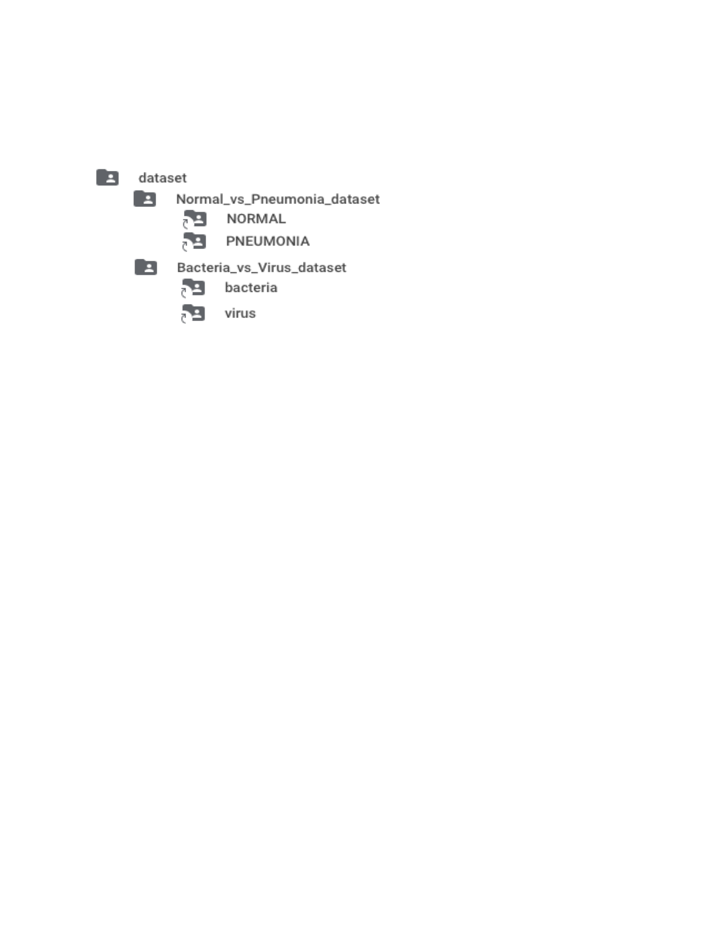
Data Processing - Folder Structure
Dataloader
Notes:
In terms of data preprocessing, the kaggle dataset has a very imbalanced division between training and validation data, as can be seen from the image on the left, there are over 5000 training images whilst only 16 validation images. Moreover, the bacterial and viral pneumonia are all under the PNEUMONIA subfolders, with filenames differentiates the two categories.
To process the image set, the team first combined all the NORMAL and PNEUMONIA subfolders under the train, val and test folders. This formed the Normal_vs_Pneumonia_dataset. We further separated the bacterial and viral pneumonia by their filenames under the PNEUMONIA subfolder and created the second image set, Bacteria_vs_Virus_dataset.
The team loaded and saved the two image sets into the data loaders separately, splitting the images into 70% training data, 15% validation data, and 15% testing data.

Slide 5
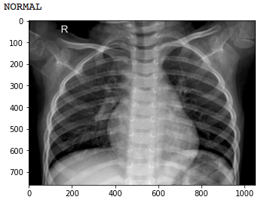
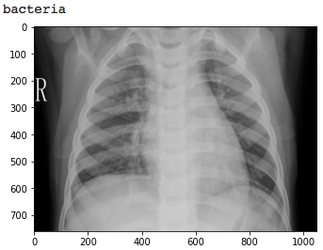
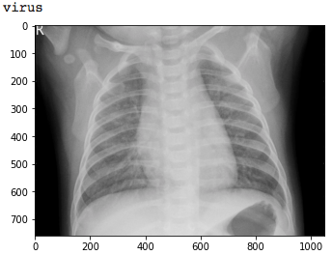
Data Processing - Image Transform
Convert from RGB (channel = 3) to Grayscale (channel = 1)
Resize to same dimension (1050 x 760)
Notes:
The images are being resized to the same dimension (1050 x 760) and converted to grayscale from RGB to decrease the complexity of the models’ input. As you can see the three preprocessed images, one from each category. The first one on the left, a normal x-ray; the middle one, bacterial pneumonia; and the last one, viral pneumonia.

Slide 6
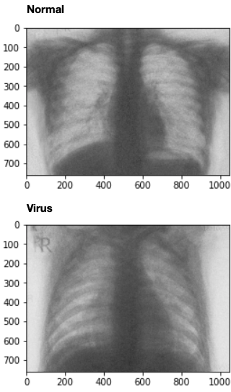
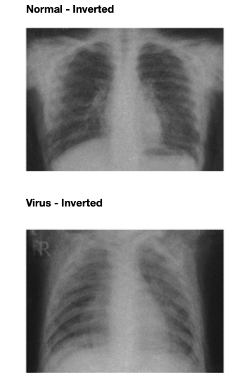
Generative Adversarial Network
Generate artificial training data for imbalanced dataset
96 extra images for normal class
128 extra images for virus class
Notes:
Since the raw dataset is imbalanced, we want to have more normal or virus class images. However, similar medical images are too expensive to acquire, so we decide to use a generative adversarial network to generate a small subset of fake training data.
Here are some examples of the fake images produced by our GAN. These images do not look real because the lung and bones are dark. But after inverting the color, it starts to look more realistic. Just like the real images, the shadow on the lung of a pneumonia image is larger compared to a normal image.

Slide 7

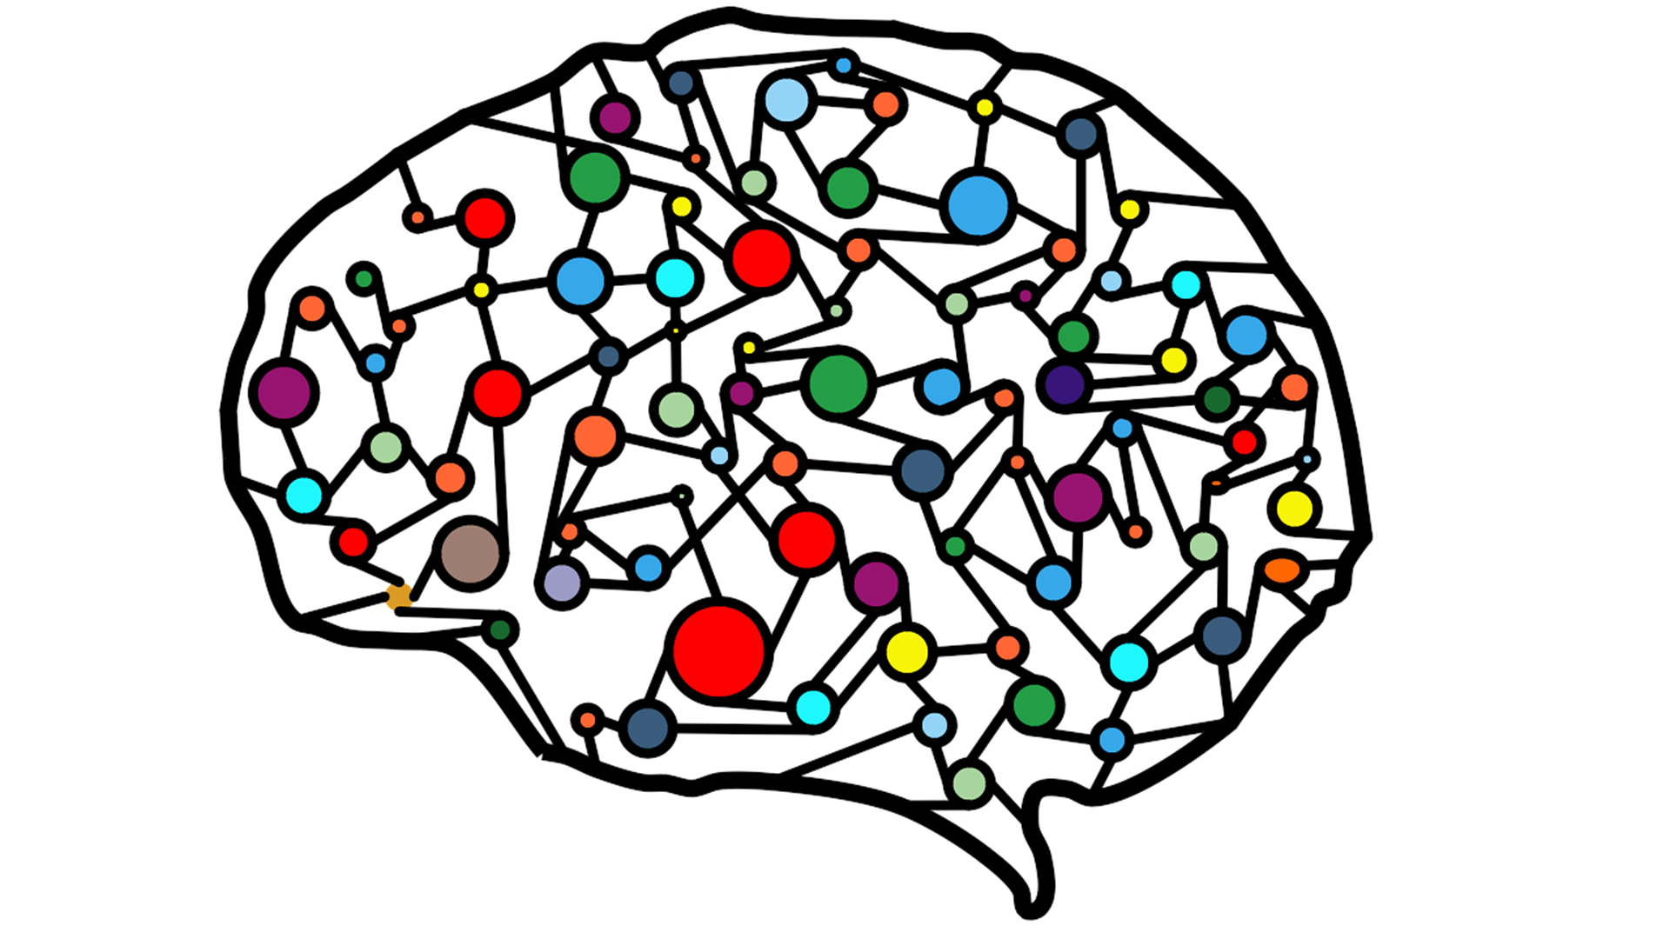
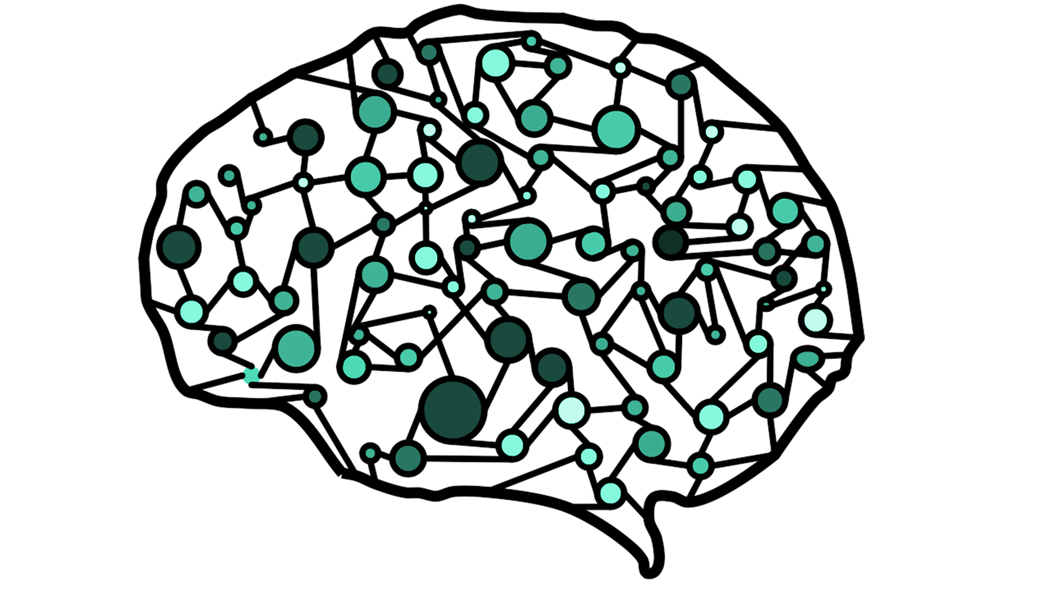
Design Choice on Model
???
???
OR
CNN
Transfer Learning
Normal vs Pneumonia (NP) validation accuracy:
93%
84%
Bacteria vs Virus (BV) validation accuracy:
77%
81%
Notes:
The team created two prototypes, CNN from scratch and transfer learning. We trained and tuned the two models separately on the same training and validation dataset and after comparing the two models, we decided to move forward with the CNN from scratch model since it achieved a higher NP validation accuracy, 93%, comparing to the 84% on transfer learning.

Slide 8
Design Choice on Model
CNN
Two Binary Convolutional Neural Networks
Normal vs Pneumonia classifier
Bacteria vs Virus classifier
Notes:
The team created 2 binary classification CNN models. One to classify if a patient is normal or have pneumonia. The other one to classify which type of pneumonia a patient has, either bacterial or viral.

Slide 9
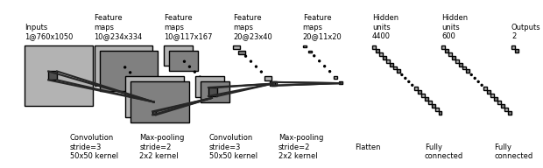
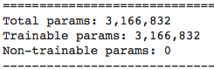
Normal vs Pneumonia (NP) Classifier
batch_size=64
num_epochs=12
learning_rate=0.0006
Notes:
The architecture of the Normal vs Pneumonia classifier consists of 10 layers in total, there are two convolutional layers, with 50*50 kernel and stride equals 3, and two max-pooling layers, with 2*2 kernel and stride equals to 2. The first convolutional layers creates 10 channels and the second layer generates 20 11*20 feature maps, which are then fed into a two-layer fully connected network. To avoid overfitting, the team also applied four 20% dropout layers on each of the convolutional and linear layers. We applied ReLU activation function between layers.
In total, there are around 3 millions 200 thousands trainable parameters in this model.
We use a batch size of 64, learning rate of 0.0006 and trained the model for 12 epochs.

Slide 10
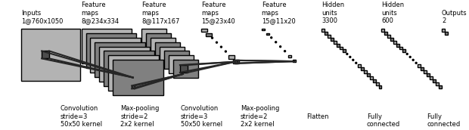
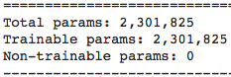
Bacteria vs Virus (BV) Classifier
batch_size=64
num_epochs=13
learning_rate=0.0003
Notes:
Similar to the NP classifier, the architecture of the Bacteria vs Virus classifier also contains two convolutional layers, with 50*50 kernel and stride equals 3, and two max-pooling layers, with 2*2 kernel and stride equals to 2. The first convolutional layers creates 8 channels and the second layer generates 15 11x20 feature maps, which are then fed into a two-layer fully connected network. Four 20% dropout layers are also applied here to avoid overfitting. ReLU activation function are used between layers.
In total, there are over 2 millions 300 thousands trainable parameters in this model.
We use a batch size of 64, learning rate of 0.0003 and trained the model for 13 epochs.

Slide 11
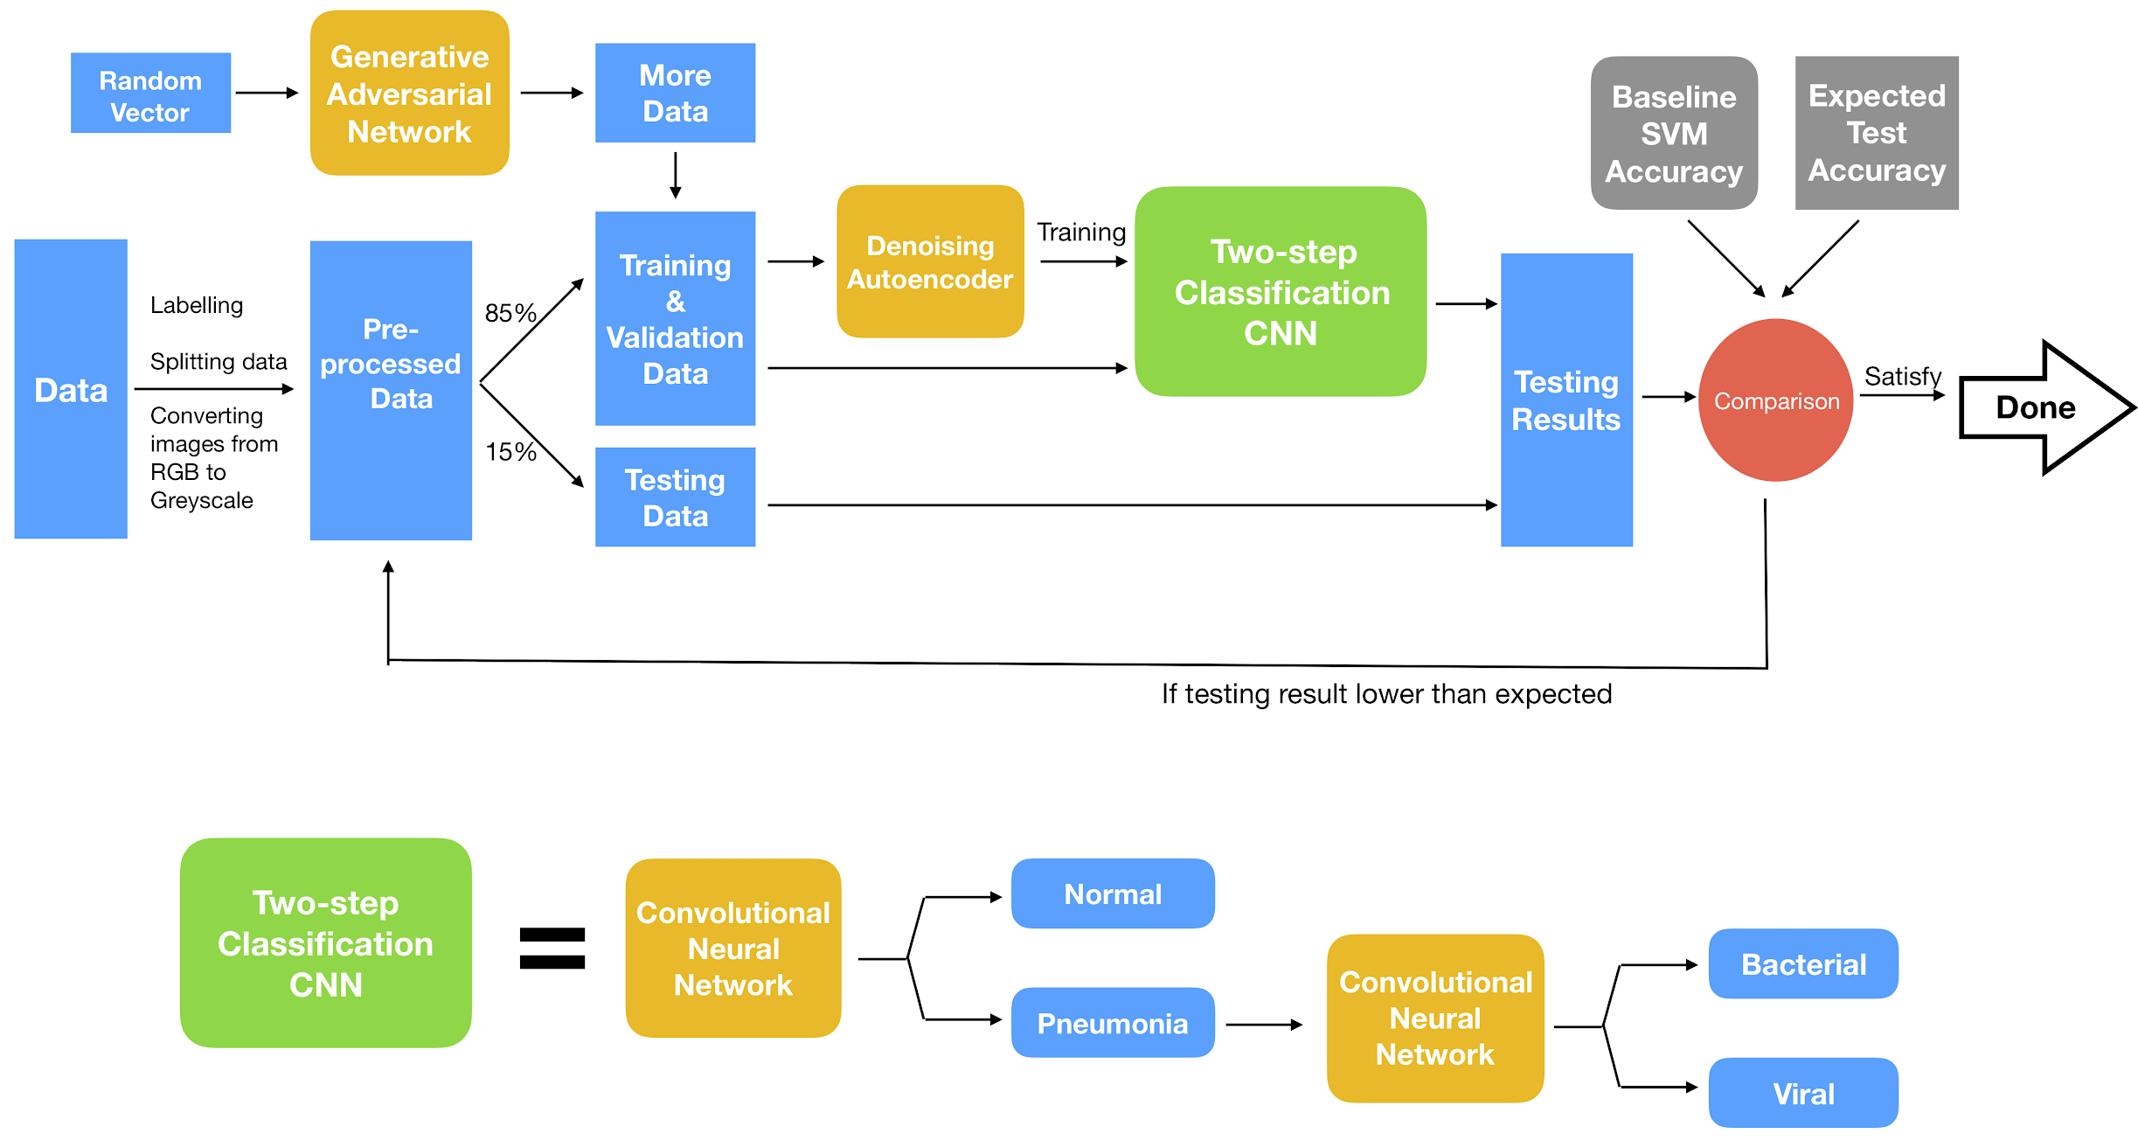
Two binary classifiers:
BV Model
NP Model
Notes:
Here’s an overview of the team’s project pipeline. After pre-processing the images, the team tried to use an autoencoder to further denoise the input images. We also used a generative adversarial network to generate more medical images. After that, there is a Two-step Classification CNN block, as show in green. Inside the modulo, the chest x-ray are first being fed into the NP model, if Pneumonia is detected, it is then pass to the second binary classifier, BV model.

Slide 12

Model Evaluations

Slide 13
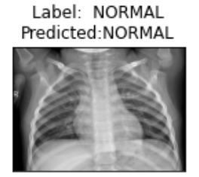
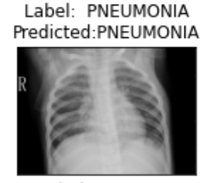
Results - NP Model
92.8%
Testing accuracy
Normal VS Pneumonia Binary Classifier with 879 testing images
True Positive Rate = 0.841
True Negative Rate = 0.967
False Positive Rate = 0.037
False Negative Rate = 0.153
*Treating pneumonia as positive
Notes:
92.8% - confusion matrix 0.967

Slide 14
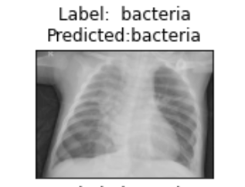
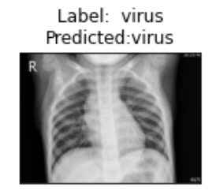
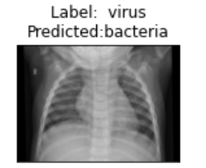
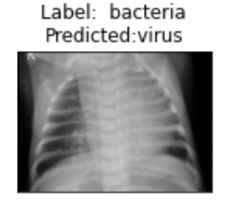
Results - BV Model
75.5%
Testing accuracy
Bacterial VS Virus Pneumonia Binary Classifier with 634 testing images
True Positive Rate = 0.833
True Negative Rate = 0.6
False Positive Rate = 0.4
False Negative Rate = 0.167
*Treating Virus pneumonia as positive
Notes:
75.5% - confusion matrix 0.833

Slide 15
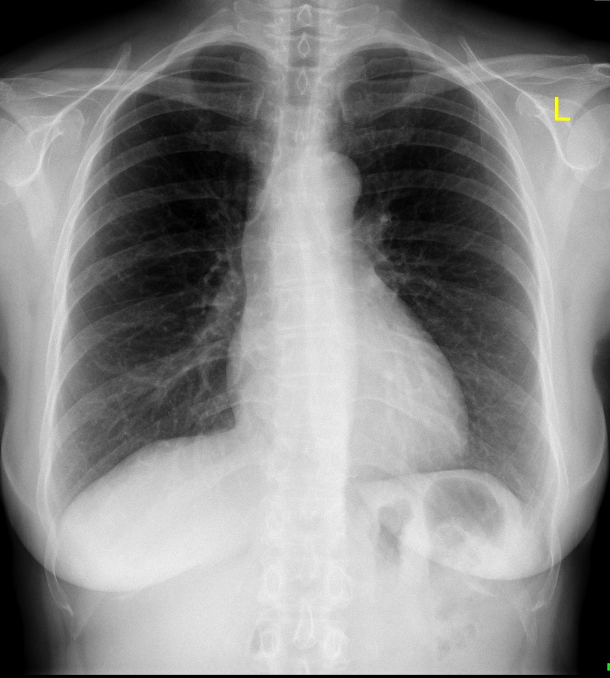
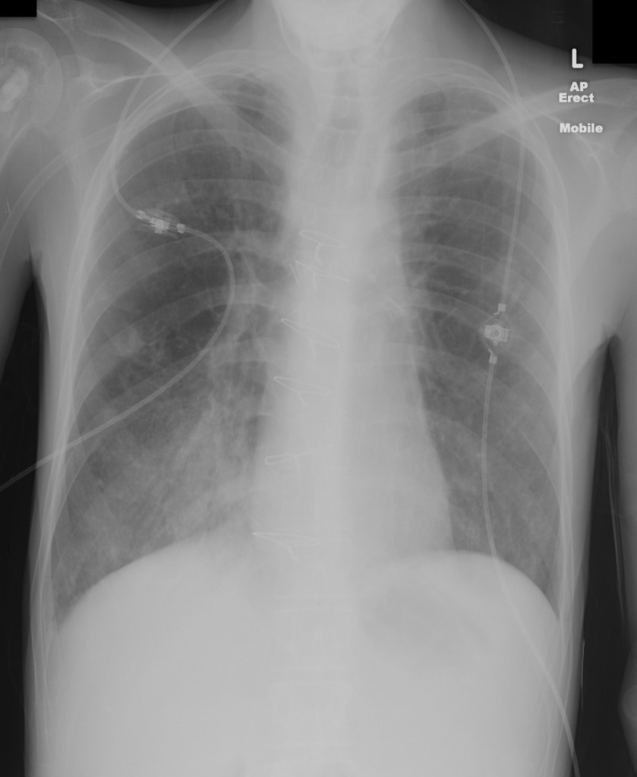
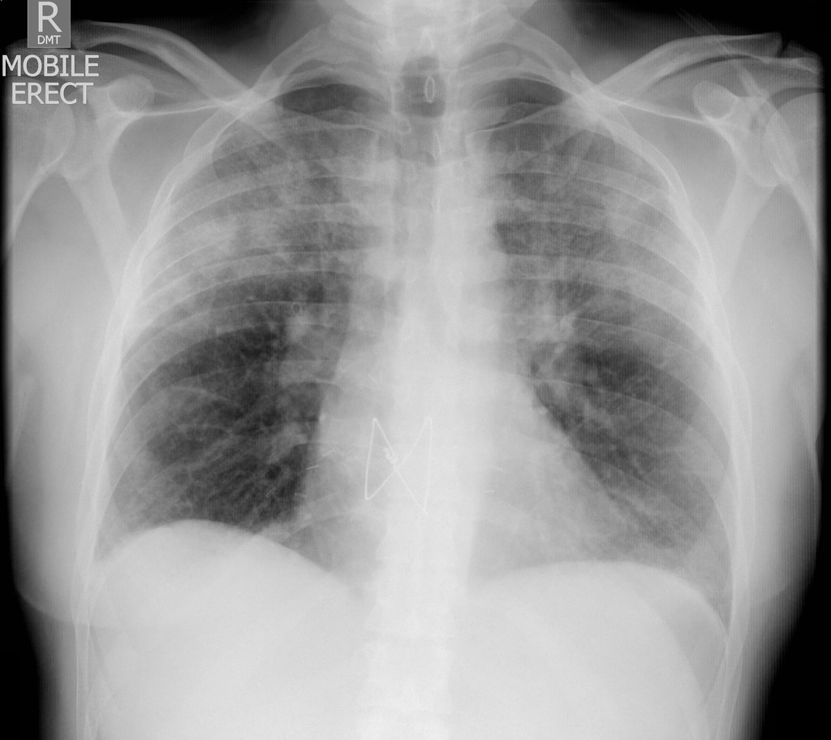
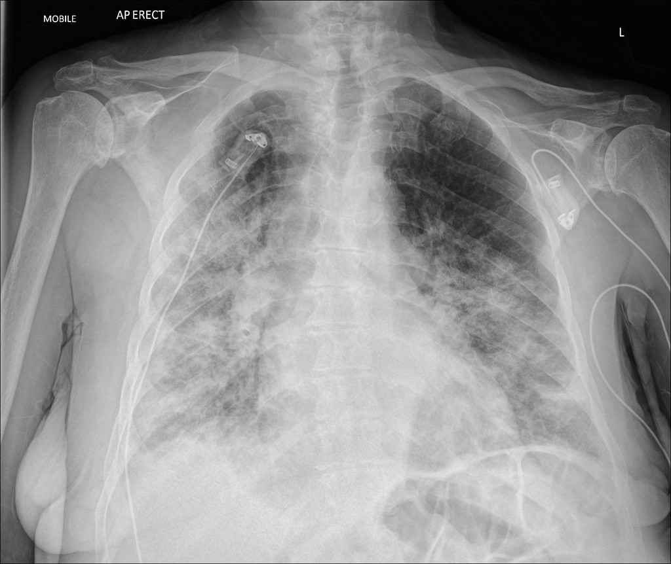
Testing on random cases from Radiopaedia
Normal
Bacterial Pneumonia
Virus
Pneumonia
COVID-19
Pneumonia

Slide 16
Discussions
NP model performs very well
BV model could still improve
92.8% 😀
75.5% 😥
40% virus class images are misclassified
How to improve BV model accuracy?
Transfer learning
High quality X-ray image dataset
Notes:
https://www.cell.com/cell/fulltext/S0092-8674(18)30154-5#fig6
Our normal-pneumonia model achieves 93% accuracy which means it’s easier for both humans and ML model to tell the difference between a normal image and pneumonia image.
However, our bacteria-virus model does not perform very well. The accuracy is only at 76%. The model performs badly at classifying virus class, up to 40% of viral pneumonia images are misclassified.
So, what’s limiting the performance of the bacteria-virus model? After analyzing the dataset, we realize that the viral pneumonia dataset is relatively small and not diverse.
To improve the BV model accuracy, we could potentially use a transfer learning model that is pre-trained on large x-ray medical image dataset, or acquire more viral pneumonia images.

Slide 17
Thanks for watching!

